Slide 1

C Practice 2
Notes:
Click to add notes

Slide 2
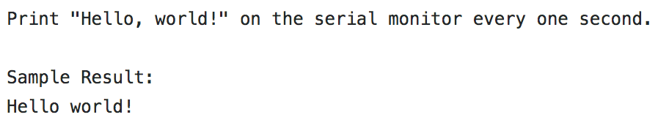
C Programming Practice Question 1
Hint:
1. Serial.println()
2. delay()
Notes:
Lesson descriptions should be brief.

Slide 3
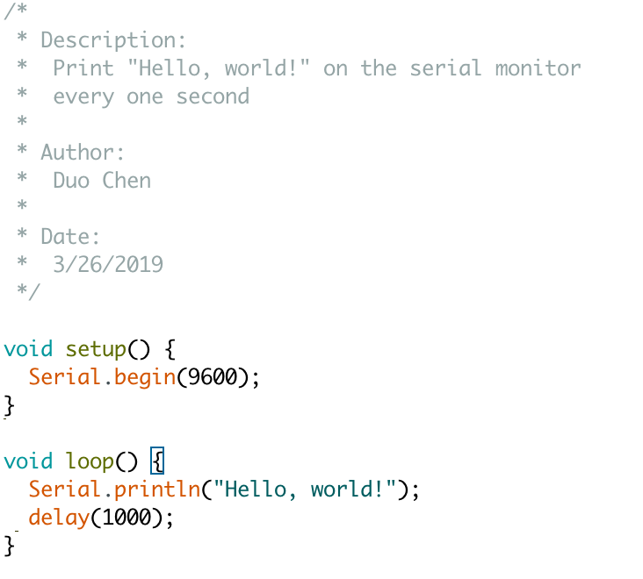
Answer
Notes:
Lesson descriptions should be brief.

Slide 4
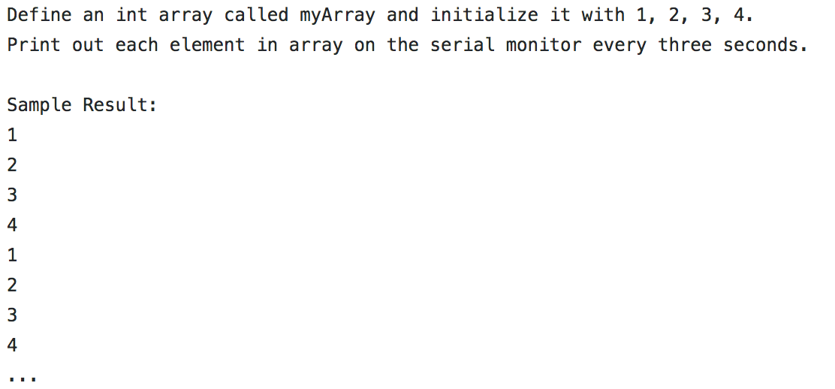
C Programming Practice Question 2
Hint:
1. myArray[i]
Notes:
Lesson descriptions should be brief.

Slide 5
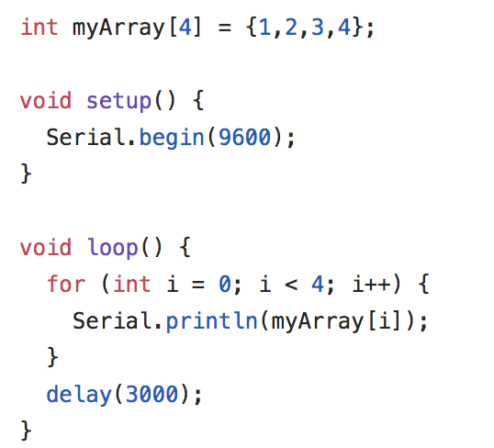
Answer
Notes:
Lesson descriptions should be brief.

